Slide 1
MULTIMEDIA SECURITY Semi-fragile Watermarking
Advisor:
Students:
Professor Mihai Mitrea
Dat Thanh Nguyen
Abdul Rehman

Slide 2
Contents
1.Introduction
2.Local Binary Patterns
3.Watermark algorithm
4.Algorithm evaluation
5.References

Slide 3
1.Introduction
What is semi-fragile watermarking:
Ability to resist unintentional manipulations caused by common image processing operations like adding noise, changing brightness, JPEG compression
Fragile against intentional, malicious manipulations

Slide 4

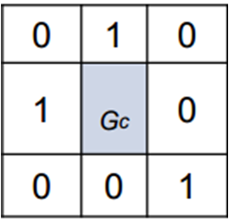

2.Local Binary Pattern
LBP indicating local contrast in neighborhood
G_{c} = gray level of center pixel c in P neighborhood
G_{p} = Gray level of neighboring pixels p
S(x) is referred as sign function
Binary Threshold function:
Notes:
Divide the examined window into cells (e.g. 3x3 pixels for each cell).  2- For each pixel in a cell, compare the pixel to each of its 8 neighbors (on its left-top, left-middle, left-bottom, right-top, etc.). Follow the pixels along a circle, i.e. clockwise or counter-clockwise.  3- Where the center pixel's value is greater than the neighbor's value, write "1". Otherwise, write "0". This gives an 8-digit binary number (which is usually converted to decimal for convenience).  4- Compute the histogram, over the cell, of the frequency of each "number" occurring (i.e., each combination of which pixels are smaller and which are greater than the center).  5- Optionally normalize the histogram.  6- Concatenate (normalized) histograms of all cells. This gives the feature vector for the window

Slide 5
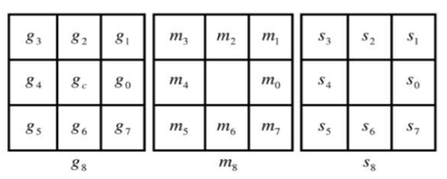
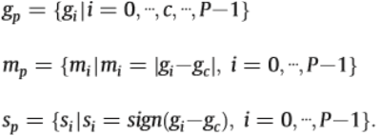

2.Local Binary Pattern
Definition on a(P,R) local region
Here a(P,R) = a(8,1) local region is given
The equation are as under:
Here Boolean function is applied on binary sign vector part Sp.

Slide 6
3.Watermark algorithm
The original image is divided into (P, R) non-overlapping local region blocks.
The LBP pattern is used to calculate mp and sp ,as well as f(sp).
Let ,
w be one of bits in the watermarks
β be the watermarking intensity factor.
Then, if ( f(s_{p})==w )
we do nothing to the neighbor pixels
else {m_{i} =min(m_{p})
if (s_{p}==1)
g_{i}=(g_{i} - m_{i})*(1- β)
if(s_{p}==0)
g_{i}=(g_{i +} m_{i})*(1+β)
end

Slide 7

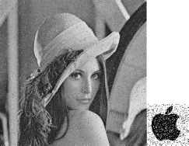

4.Algorithm evaluation
9 levels of noises ( "On and Off" pixels, density from 0.01 to 0.09) is added to watermarked image
Quality levels from 50 to 100 for JPEG compression.
Changing contrast level: [-100:100]
Apply tamper on Lena's hat

Slide 8
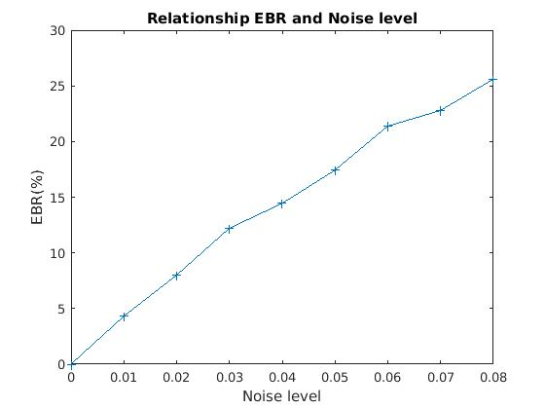
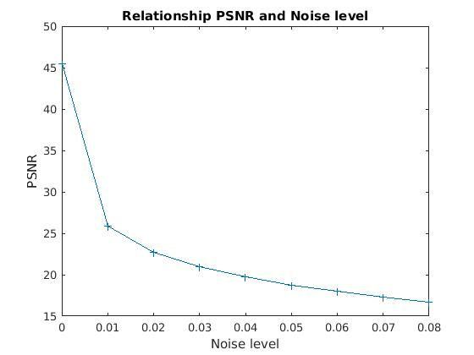
4.Algorithm evaluation

Slide 9
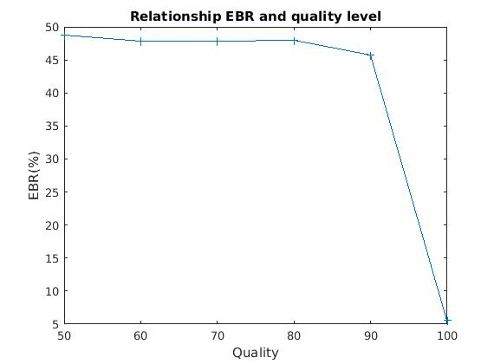
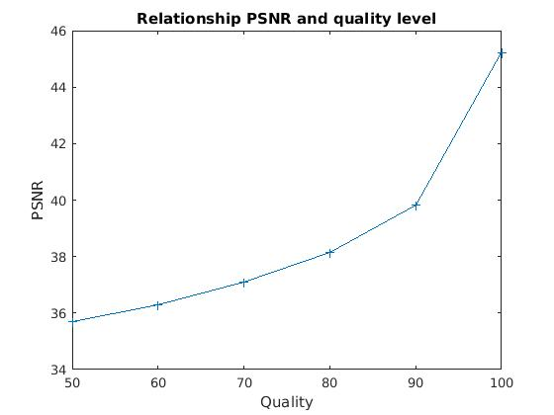
4.Algorithm evaluation

Slide 10
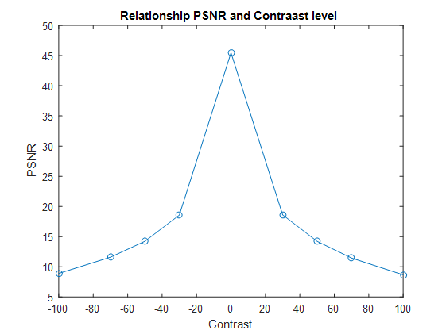
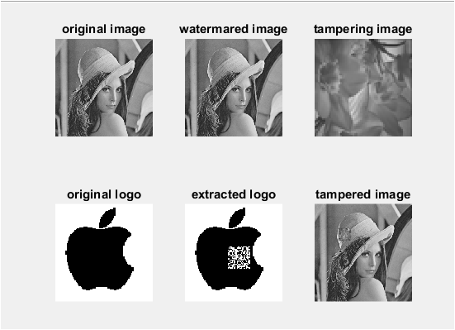
4.Algorithm Evaluation

Slide 11
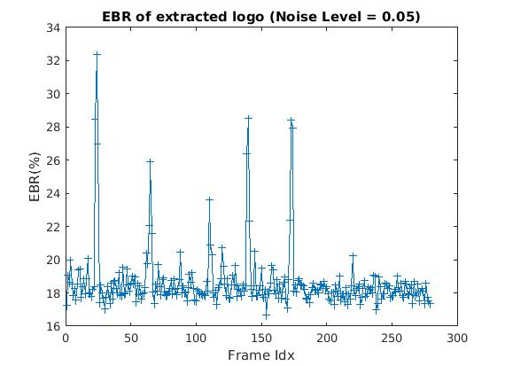
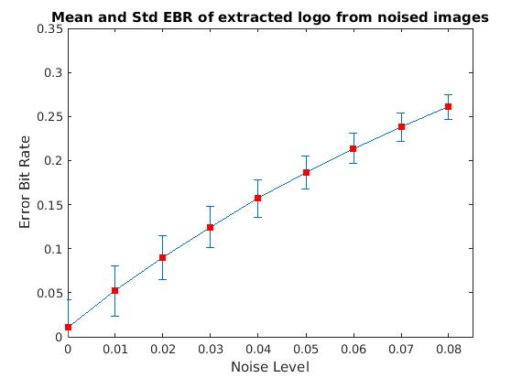
4.Algorithm evaluation
Testing with dataset: 279 images

Slide 12
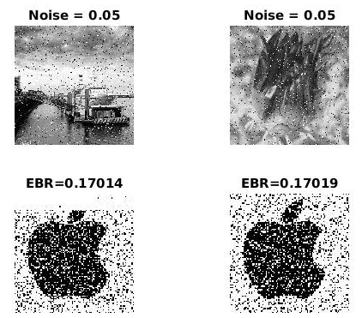
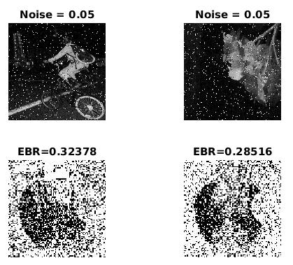
4.Algorithm evaluation
Testing with dataset: 279 images
Top 2 image having best and worst EBR

Slide 13
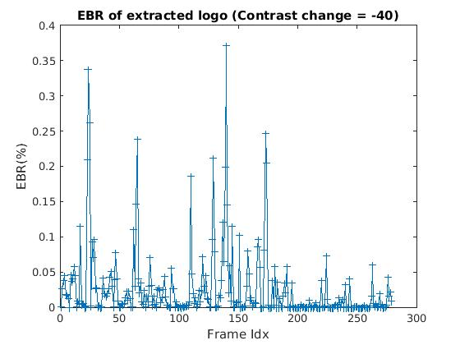
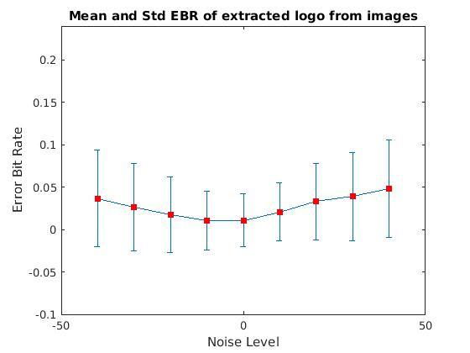
4.Algorithm evaluation
Testing with dataset: 279 images
Contrast

Slide 14
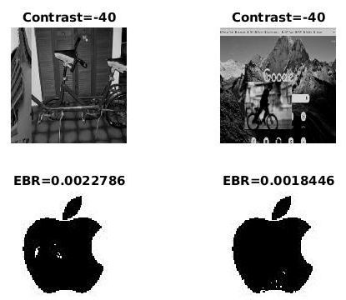
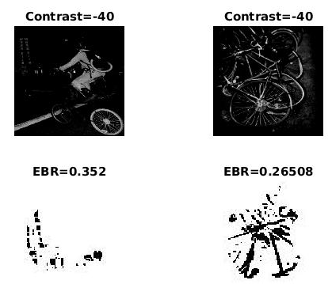
4.Algorithm evaluation
Testing with dataset: 279 images
Top 2 image having best and worst EBR

Slide 15
5.References
Wenyin, Zhang, and Frank Y. Shih. "Semi-fragile spatial watermarking based on local binary pattern operators." Optics Communications 284.16-17 (2011): 3904-3912.

Slide 16
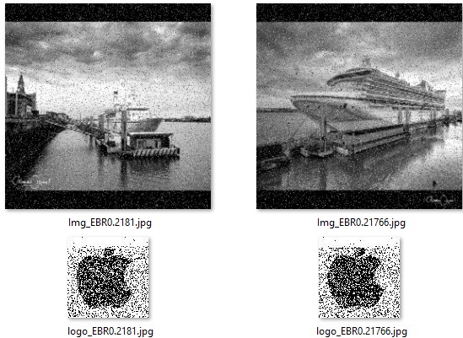
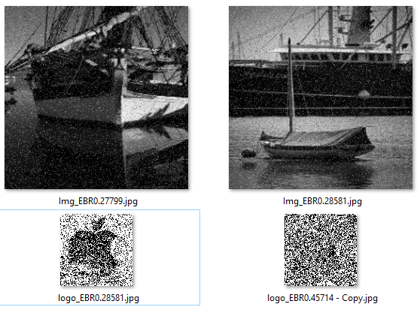
Algorithm evaluation
Testing with dataset: 279 images
Top 2 image having best and worst EBR

Slide 17
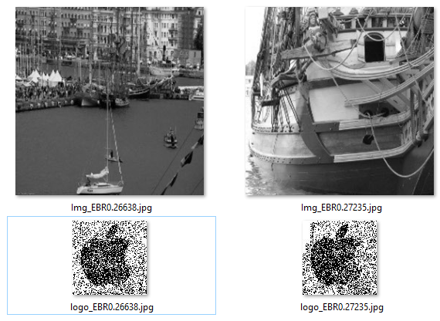
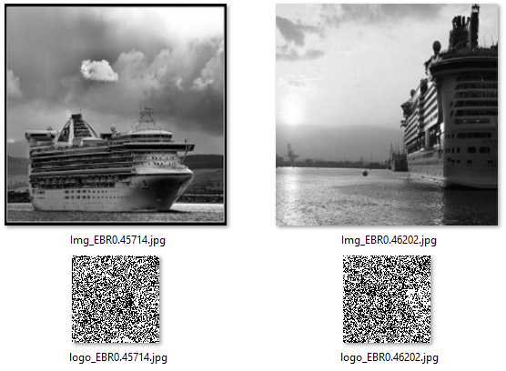
Algorithm evaluation
Testing with dataset: 279 images
Top 2 image having best and worst EBR

Slide 18
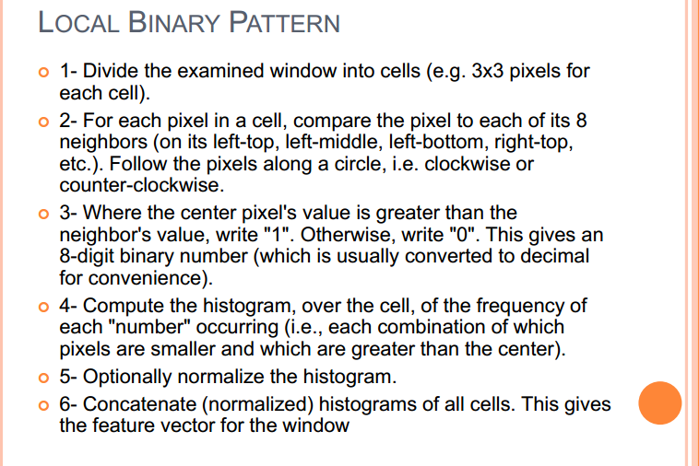

Slide 19
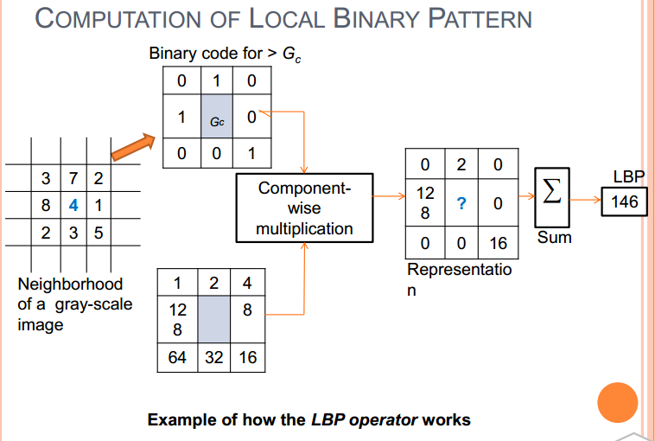

Slide 20
